Slide 1
CYCLISTIC BIKE – SHARE ANALYSIS
By Sasikumar sha

Slide 2
CONTENTS
01
30 Days of Historical Data analysis using Power BI
02
Type of Bike - Docked Bike vs. electric Bike
03
Type of Rides – Casual Rider & Member Rider

Slide 3
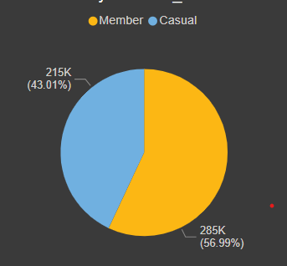
CYCLISTIC BIKE – SHARE ANALYSIS
Users of Cyclistic bike-share services are categorised into two types: Cyclistic members and Casual riders. The pie chart below shows the total number of trips each kind of user took from Sept 2020
Cyclistic members have recorded higher activity with approximately 285K trips. That is 56.99% of the total trips taken.
Casual riders have recorded their activity with approximately 215K trips. That is 43.01% of the total trips taken

Slide 4
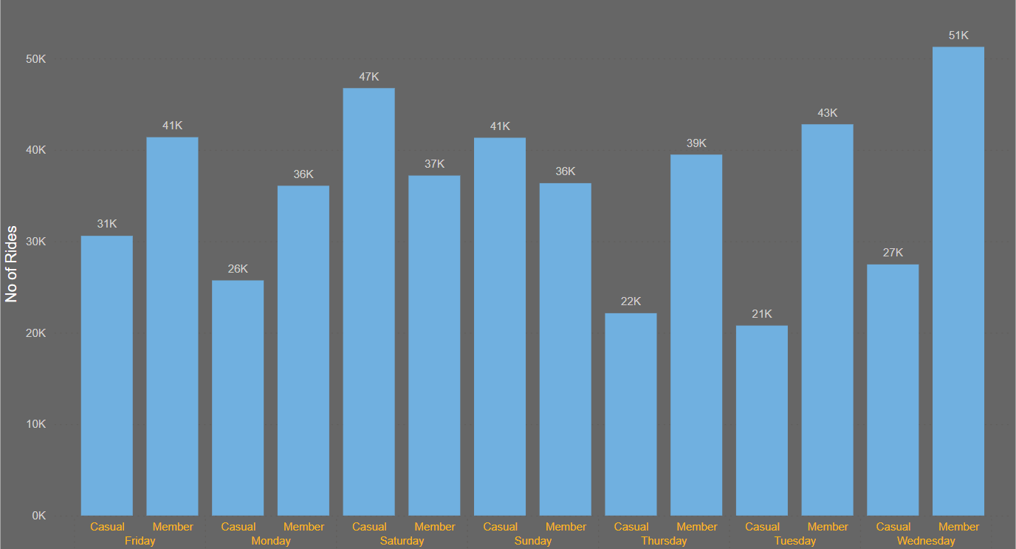
CYCLISTIC BIKE – SHARE ANALYSIS
Cyclistic Members recorded their highest activity on Wednesday, with 51K trips, and the lowest on Sunday & Monday, with 36K trips.
Cyclistic Casual Riders recorded its highest activity on Saturday, with 47K trips, and the lowest in Tuesday, with 21K trips.

Slide 5
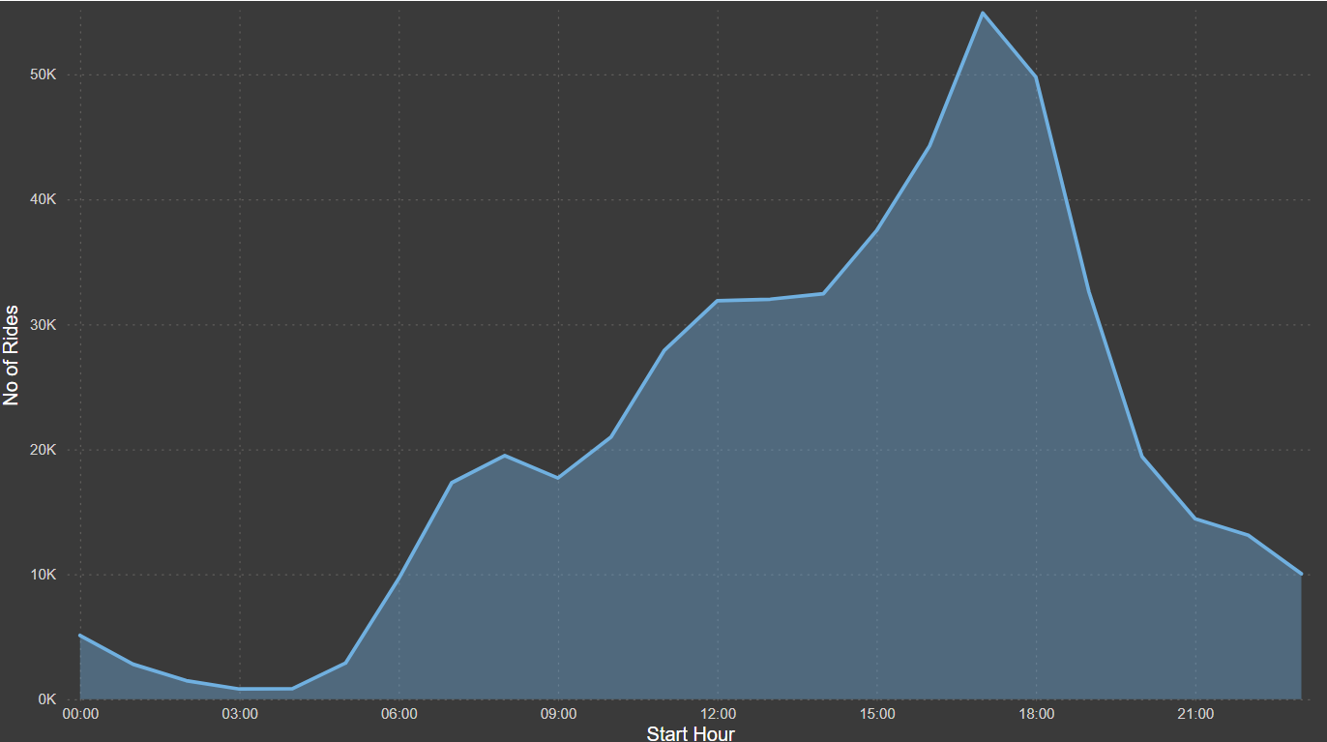
CYCLISTIC BIKE – SHARE ANALYSIS
Cyclistic members frequented most at 17 Hours, with approximately 32,224 trips and the least at 24 Hours, with about 1705 trips.
Casual riders frequented most at 17 Hours, with approximately 22,686 trips and the least at 12 hours, with about 3398 trips.

Slide 6
Average Travel length – 16.30minutes
Mostly Docked Bike Used around 80%
Highest Ride on Wednesday
Lowest Ride on Tuesday
Total No. of Rides 499K
Most Key parameter

Slide 7
CYCLISTIC BIKE – SHARE ANALYSIS
Recommendations.
Provide more offers for E-Bikes so they can use the E-Bike service more often and develop an
APP for user-friendly.
Provide promotions for Casual Riders at weekends and weekdays equally, so will have more exposure to convert members.
Offer priority access during busy hours and discounted pricing during non-busy hours for Cyclistic members only — this would encourage casual riders to apply for an annual membership.
Introduce to Rewards Points Programme, it will help to increase more rides as well as membership.
We will introduce an extra Rewards points programme on their accusation days or months, it will help to avoid losing membership existing members.

Slide 8
THANK YOU

